Slide 1

Robot Maze Rumble
Presenter
2b || ! 2b
Notes:
This is a fixed Carnegie Mellon image.
Place your cursor on the white text above and type in your text.
Main title: 40 pt. Times, Upper & lower case.
Presenter: 16 pt. Helvetica oblique
Name: 16 pt. Helvetica Bold
Presenters Title: 16 pt. Helvetica light

Slide 2
Game
Aim: To beat the computer in a race through a maze.
Features:
Random Maze generation
Levels of increasing difficulty
Tutorial to guide the user how to play the game
Feature to save and load the game
Scoreboard to display and compare performance of players

Slide 3
Components
Maze: The path through which both robots have to navigate
Robot: Plans the path for the computer robot; moves human robot based on user input
Tutorial: Demonstrates the main features of the game and shows gameplay
Menu: Navigates through various features and levels of the game
Game: Link Between all codes

Slide 4
Member contributions
Maze: Akash Sambrekar, Rahul Patil
Robot and Astar: Akshay Hinduja, Purva Joshi, Rohan Biwalkar
Tutorial: Genesis Vasquez
Menu: Ashwin Prabhu
Game and Integration: Ninad Kamat
Presentation and User guide: Akshay Hinduja, Purva Joshi, Rohan Biwalkar
Compile Instructions: Ninad Kamat, Rahul Patil, Ashwin Prabhu

Slide 5
The Maze Class
Key considerations
Multiple options
Storing multiple mazes
Loading multiple mazes available online
Issue :
Takes up too much memory
Perhaps not a smart way!

Slide 6
Can we take advantage of random numbers?

Slide 7
The Rosetta Algorithm

Slide 8
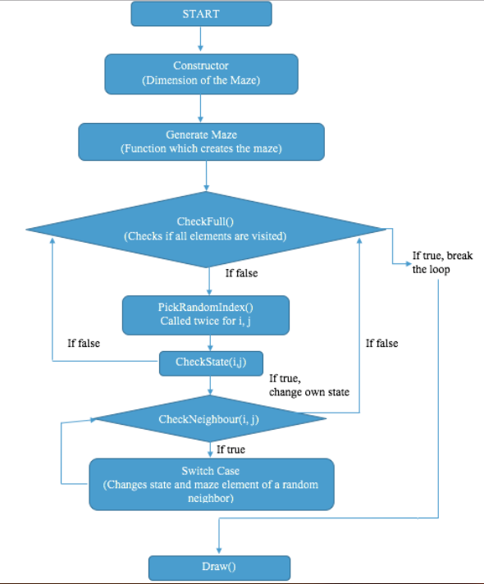
Maze Class
The Rosetta Algorithm
Set the matrix like this
State of each cell is zero (1: path; 0: wall)
1 | 1 | 1 | 1 | 1 | 1 | 1 | 1 | 1
1 | 0 | 1 | 0 | 1 | 0 | 1 | 0 | 1
1 | 1 | 1 | 1 | 1 | 1 | 1 | 1 | 1
1 | 0 | 1 | 0 | 1 | 0 | 1 | 0 | 1
1 | 1 | 1 | 1 | 1 | 1 | 1 | 1 | 1
1 | 0 | 1 | 0 | 1 | 0 | 1 | 0 | 1
1 | 1 | 1 | 1 | 1 | 1 | 1 | 1 | 1
1 | 0 | 1 | 0 | 1 | 0 | 1 | 0 | 1
1 | 1 | 1 | 1 | 1 | 1 | 1 | 1 | 1
Notes:
When typing text, insert the cursor on text above and start typing. Highlight text you do not want and press delete.
The placement of text blocks are strategically placed to relate to your intro slide (#1).
Main title: 40 pt. Times, Upper & lower case.
Subheads/Name: 16 pt. Helvetica Bold
Text: 16 pt. Helvetica light
Titles, papers, periodicals: 16 pt. Helvetica oblique

Slide 9
Maze Generation
No Neighbor
Check Neighbor
Check State
1 | 1 | 1 | 1 | 1 | 1 | 1 | 1 | 1
1 | 0 | 1 | 0 | 1 | 0 | 1 | 0 | 1
1 | 1 | 1 | 1 | 1 | 1 | 1 | 1 | 1
1 | 0 | 1 | 0 | 1 | 0 | 1 | 0 | 1
1 | 1 | 1 | 1 | 1 | 1 | 1 | 1 | 1
1 | 0 | 1 | 0 | 1 | 0 | 1 | 0 | 1
1 | 1 | 1 | 1 | 1 | 1 | 1 | 1 | 1
1 | 0 | 1 | 0 | 1 | 0 | 1 | 0 | 1
1 | 1 | 1 | 1 | 1 | 1 | 1 | 1 | 1
No Neighbor
Pick Random Index
Check Full
Notes:
When typing text, insert the cursor on text above and start typing. Highlight text you do not want and press delete.
The placement of text blocks are strategically placed to relate to your intro slide (#1).
Main title: 40 pt. Times, Upper & lower case.
Subheads/Name: 16 pt. Helvetica Bold
Text: 16 pt. Helvetica light
Titles, papers, periodicals: 16 pt. Helvetica oblique

Slide 10
Maze Generation
Check Neighbor
Check State
1 | 1 | 1 | 1 | 1 | 1 | 1 | 1 | 1
1 | 0 | 0 | 0 | 1 | 0 | 1 | 0 | 1
1 | 1 | 1 | 1 | 1 | 1 | 1 | 1 | 1
1 | 0 | 1 | 0 | 1 | 0 | 1 | 0 | 1
1 | 1 | 1 | 1 | 1 | 1 | 1 | 1 | 1
1 | 0 | 1 | 0 | 1 | 0 | 1 | 0 | 1
1 | 1 | 1 | 1 | 1 | 1 | 1 | 1 | 1
1 | 0 | 1 | 0 | 1 | 0 | 1 | 0 | 1
1 | 1 | 1 | 1 | 1 | 1 | 1 | 1 | 1
Pick Random Index
Check Full
Notes:
When typing text, insert the cursor on text above and start typing. Highlight text you do not want and press delete.
The placement of text blocks are strategically placed to relate to your intro slide (#1).
Main title: 40 pt. Times, Upper & lower case.
Subheads/Name: 16 pt. Helvetica Bold
Text: 16 pt. Helvetica light
Titles, papers, periodicals: 16 pt. Helvetica oblique

Slide 11
Maze Generation
Check Neighbor
Check State
1 | 1 | 1 | 1 | 1 | 1 | 1 | 1 | 1
1 | 0 | 0 | 0 | 1 | 0 | 1 | 0 | 1
1 | 1 | 1 | 0 | 1 | 1 | 1 | 1 | 1
1 | 0 | 1 | 0 | 1 | 0 | 1 | 0 | 1
1 | 1 | 1 | 1 | 1 | 1 | 1 | 1 | 1
1 | 0 | 1 | 0 | 1 | 0 | 1 | 0 | 1
1 | 1 | 1 | 1 | 1 | 1 | 1 | 1 | 1
1 | 0 | 1 | 0 | 1 | 0 | 1 | 0 | 1
1 | 1 | 1 | 1 | 1 | 1 | 1 | 1 | 1
Pick Random Index
Check Full
Notes:
When typing text, insert the cursor on text above and start typing. Highlight text you do not want and press delete.
The placement of text blocks are strategically placed to relate to your intro slide (#1).
Main title: 40 pt. Times, Upper & lower case.
Subheads/Name: 16 pt. Helvetica Bold
Text: 16 pt. Helvetica light
Titles, papers, periodicals: 16 pt. Helvetica oblique

Slide 12
Maze Generation
Check Neighbor
Check State
1 | 1 | 1 | 1 | 1 | 1 | 1 | 1 | 1
1 | 0 | 0 | 0 | 1 | 0 | 1 | 0 | 1
1 | 1 | 1 | 0 | 1 | 1 | 1 | 1 | 1
1 | 0 | 1 | 0 | 1 | 0 | 1 | 0 | 1
1 | 1 | 1 | 0 | 1 | 1 | 1 | 1 | 1
1 | 0 | 1 | 0 | 1 | 0 | 1 | 0 | 1
1 | 1 | 1 | 1 | 1 | 1 | 1 | 1 | 1
1 | 0 | 1 | 0 | 1 | 0 | 1 | 0 | 1
1 | 1 | 1 | 1 | 1 | 1 | 1 | 1 | 1
Pick Random Index
Check Full
Notes:
When typing text, insert the cursor on text above and start typing. Highlight text you do not want and press delete.
The placement of text blocks are strategically placed to relate to your intro slide (#1).
Main title: 40 pt. Times, Upper & lower case.
Subheads/Name: 16 pt. Helvetica Bold
Text: 16 pt. Helvetica light
Titles, papers, periodicals: 16 pt. Helvetica oblique

Slide 13
Maze Generation
Check Neighbor
Check State
1 | 1 | 1 | 1 | 1 | 1 | 1 | 1 | 1
1 | 0 | 0 | 0 | 1 | 0 | 1 | 0 | 1
1 | 1 | 1 | 0 | 1 | 1 | 1 | 1 | 1
1 | 0 | 1 | 0 | 1 | 0 | 1 | 0 | 1
1 | 1 | 1 | 0 | 1 | 1 | 1 | 1 | 1
1 | 0 | 0 | 0 | 1 | 0 | 1 | 0 | 1
1 | 1 | 1 | 1 | 1 | 1 | 1 | 1 | 1
1 | 0 | 1 | 0 | 1 | 0 | 1 | 0 | 1
1 | 1 | 1 | 1 | 1 | 1 | 1 | 1 | 1
Pick Random Index
Check Full
Notes:
When typing text, insert the cursor on text above and start typing. Highlight text you do not want and press delete.
The placement of text blocks are strategically placed to relate to your intro slide (#1).
Main title: 40 pt. Times, Upper & lower case.
Subheads/Name: 16 pt. Helvetica Bold
Text: 16 pt. Helvetica light
Titles, papers, periodicals: 16 pt. Helvetica oblique

Slide 14
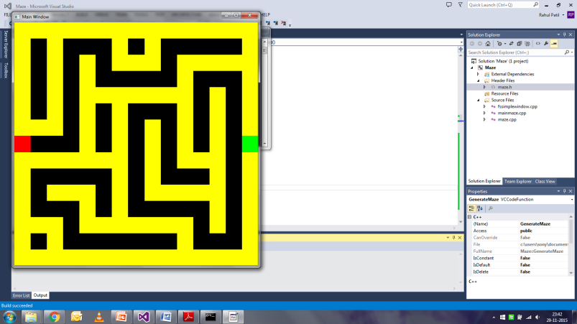
Maze Generation
No place to move!
Pick new random index and the same process continues
The loop runs until all the zero cells are visited
1 | 1 | 1 | 1 | 1 | 1 | 1 | 1 | 1
1 | 0 | 0 | 0 | 1 | 0 | 1 | 0 | 1
1 | 1 | 1 | 0 | 1 | 1 | 1 | 1 | 1
1 | 0 | 1 | 0 | 1 | 0 | 1 | 0 | 1
1 | 0 | 1 | 0 | 1 | 1 | 1 | 1 | 1
1 | 0 | 0 | 0 | 1 | 0 | 1 | 0 | 1
1 | 1 | 1 | 1 | 1 | 1 | 1 | 1 | 1
1 | 0 | 1 | 0 | 1 | 0 | 1 | 0 | 1
1 | 1 | 1 | 1 | 1 | 1 | 1 | 1 | 1
x
x
x
Sample Maze
x
Notes:
When typing text, insert the cursor on text above and start typing. Highlight text you do not want and press delete.
The placement of text blocks are strategically placed to relate to your intro slide (#1).
Main title: 40 pt. Times, Upper & lower case.
Subheads/Name: 16 pt. Helvetica Bold
Text: 16 pt. Helvetica light
Titles, papers, periodicals: 16 pt. Helvetica oblique

Slide 15
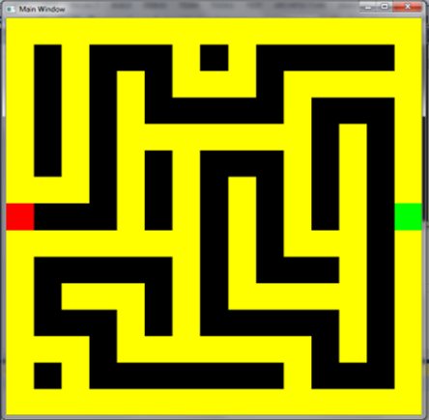
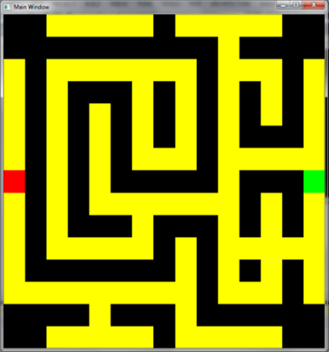
Bugs
Bug: There is always a path along the corner
Fix: Creating wall at the 4 corners and midpoints of top and bottom
Notes:
When typing text, insert the cursor on text above and start typing. Highlight text you do not want and press delete.
The placement of text blocks are strategically placed to relate to your intro slide (#1).
Main title: 40 pt. Times, Upper & lower case.
Subheads/Name: 16 pt. Helvetica Bold
Text: 16 pt. Helvetica light
Titles, papers, periodicals: 16 pt. Helvetica oblique

Slide 16
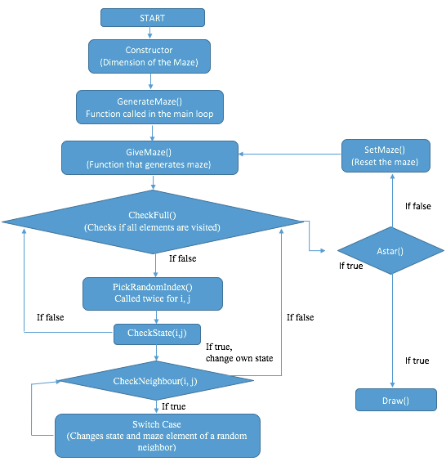
Bugs
Bug: No path available at times
Notes:
When typing text, insert the cursor on text above and start typing. Highlight text you do not want and press delete.
The placement of text blocks are strategically placed to relate to your intro slide (#1).
Main title: 40 pt. Times, Upper & lower case.
Subheads/Name: 16 pt. Helvetica Bold
Text: 16 pt. Helvetica light
Titles, papers, periodicals: 16 pt. Helvetica oblique

Slide 17
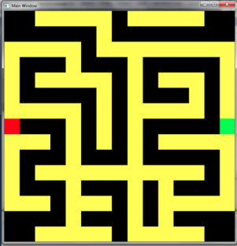
Fix
Now there is a path
Notes:
When typing text, insert the cursor on text above and start typing. Highlight text you do not want and press delete.
The placement of text blocks are strategically placed to relate to your intro slide (#1).
Main title: 40 pt. Times, Upper & lower case.
Subheads/Name: 16 pt. Helvetica Bold
Text: 16 pt. Helvetica light
Titles, papers, periodicals: 16 pt. Helvetica oblique

Slide 18
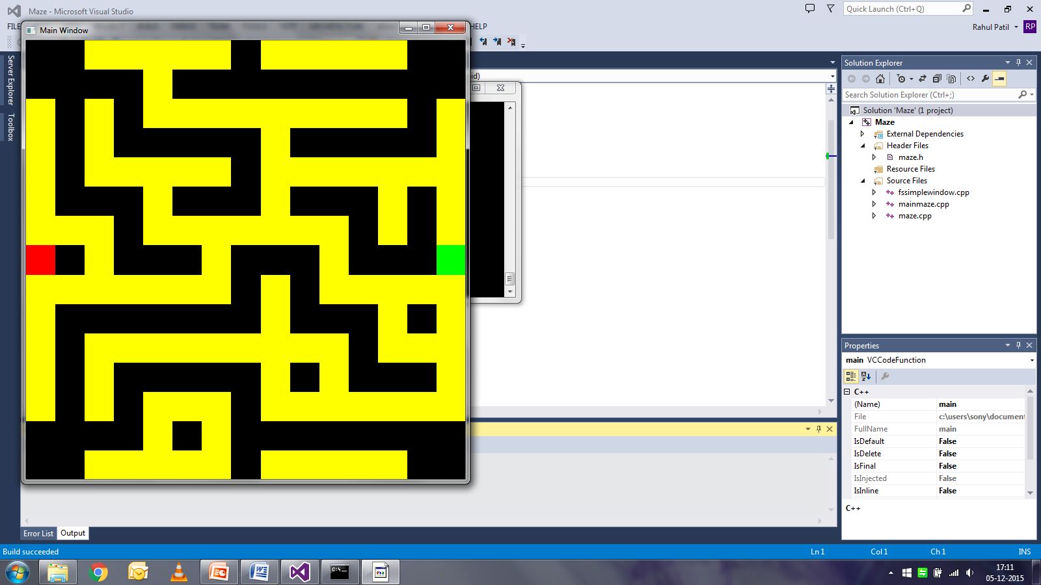
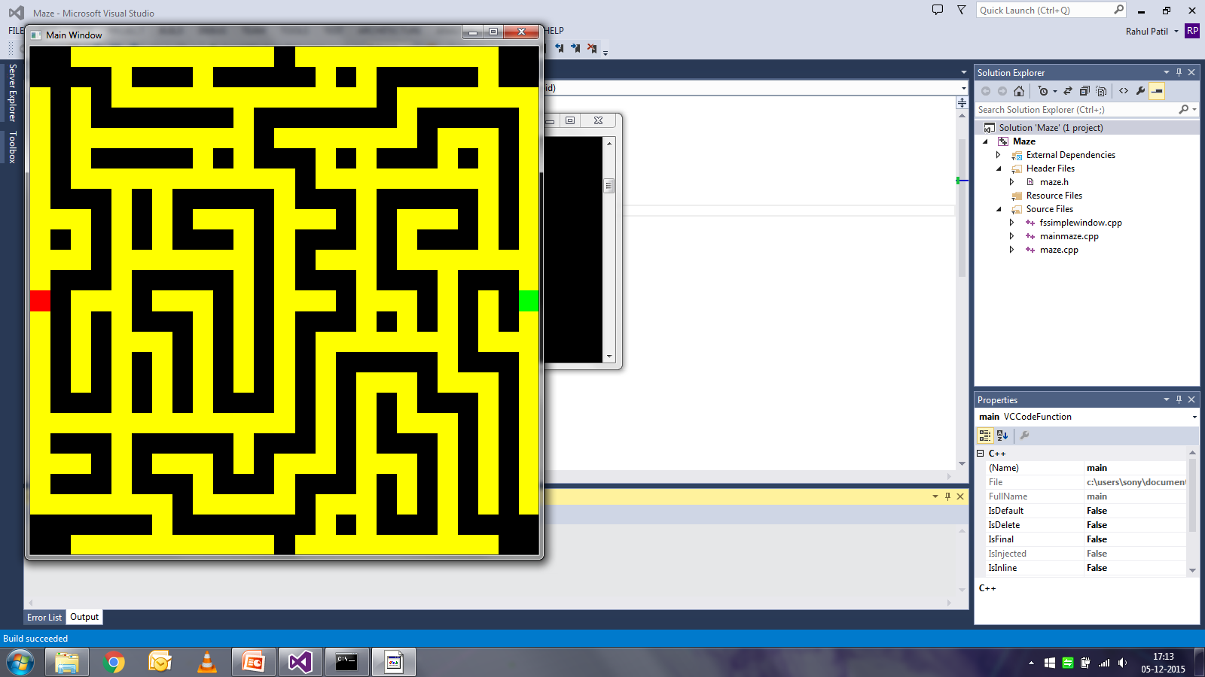
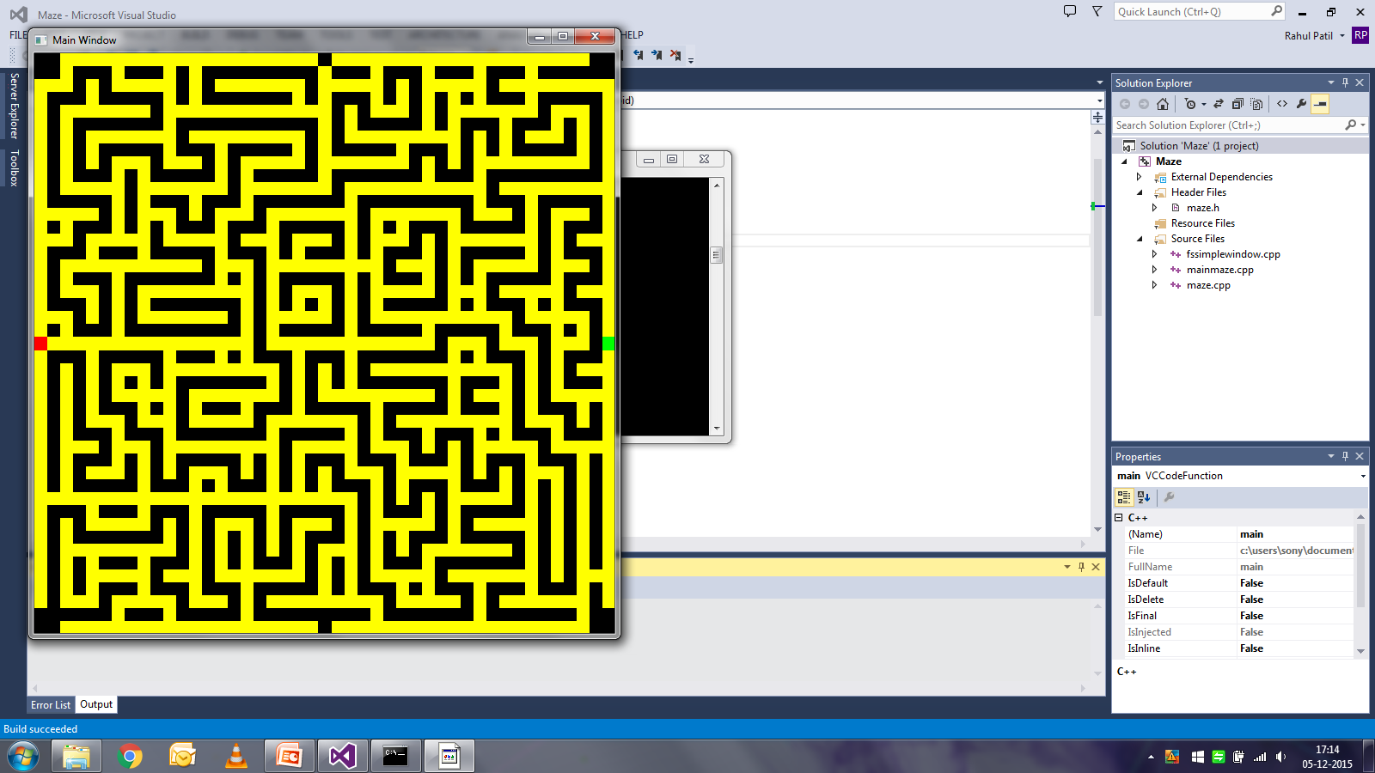
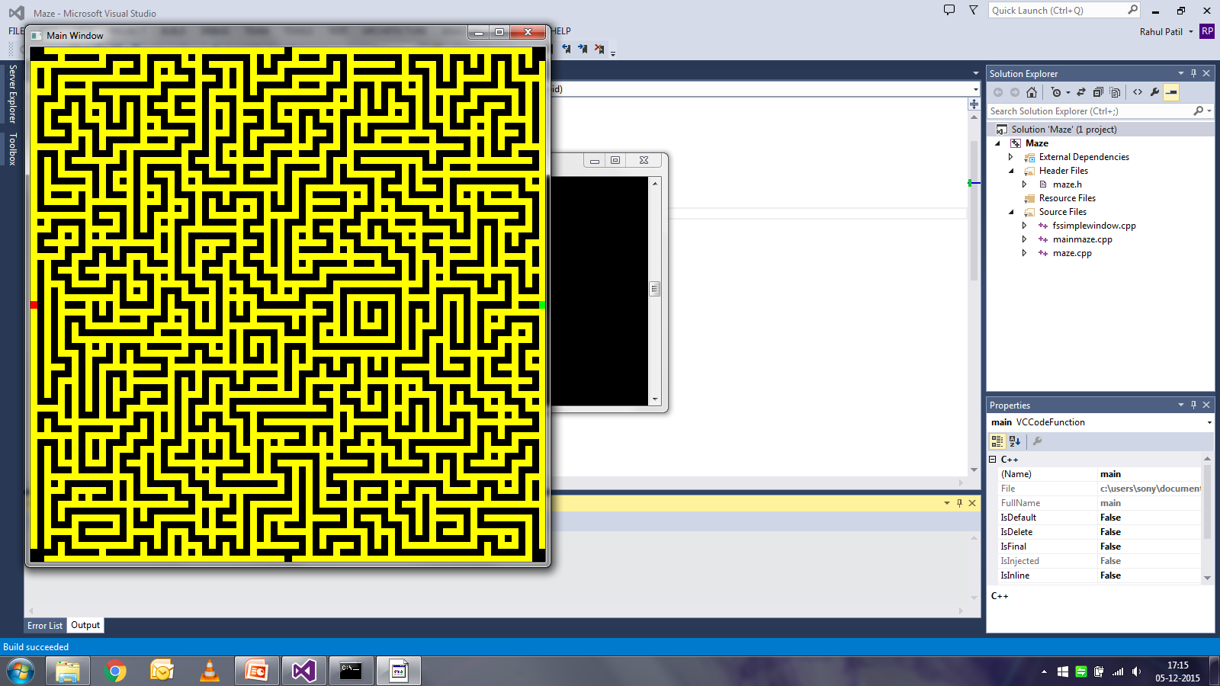
Maze Levels
Notes:
When typing text, insert the cursor on text above and start typing. Highlight text you do not want and press delete.
The placement of text blocks are strategically placed to relate to your intro slide (#1).
Main title: 40 pt. Times, Upper & lower case.
Subheads/Name: 16 pt. Helvetica Bold
Text: 16 pt. Helvetica light
Titles, papers, periodicals: 16 pt. Helvetica oblique

Slide 19
A-star algorithm
The A* algorithm uses a best-first search to find the least-cost path from an initial position to a final position using a heuristic function to guide itself.
It is mathematically represented as f(n) = g(n) + h(n)
As the algorithm travels through the grid, it builds up a tree of partial paths.
Each end of this tree is a part of the open set which are sorted as per the least cost.
The lowest f(n) is chosen as the next node which again builds a tree of its neighbors.

Slide 20
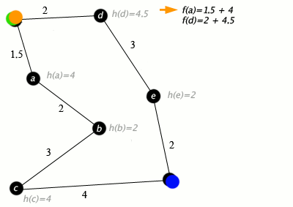

Calculation of f(n) and Graphical Representation

Slide 21
Flow Chart
Set initial node and place it in the priority queue, compute h(n) for all nodes
Calculate F(n) for all neighboring nodes = g(n) + h(n), placing them all in the priority queue
Select the node from the priority queue with the lowest f(n) score, call it S
Remove S from the priority queue.
For each adjacent node T,
If visited, ignore it.
If not visited, compute the scores and add to priority queue
Using the priority queue we trace back the path to be taken from the finish node to the start node.

Slide 22
Robot
Computer Robot:
Path decided by the A-star algorithm.
Hashing
Movement decided by the vector path.
Speed of computer slower than the human robot.

Slide 23
Robot
Human Robot:
Has two degrees of freedom.
Each arrow key is assigned a particular function for effective navigation
The speed of the robot is pre-decided by the forward vector for movement
Camera angle helps the user to navigate through the maze
Maze mini-map helps the user to visualize the position of both robots in the entire maze

Slide 24
Bug Fixes
Type Casting error: Incorrect int values recovered from hashed double value. Fixed by adding 0.5 to the double value in order to get the correct int value.
Closing the visited cells: In the initial version, algorithm would be stuck between two cells, and wrong cells would be filled in the ‘closed’ array, resulting in the wrong path). Fixed by changing the ‘closed’ variable of each node to 1 (which indicated that it had been visited).
Wrong minimum calculation: Comparison of hashed f-values gave wrong minimum value. Fixed by typecasting double to int before comparison.
Wrong boundary conditions: Out of bounds nodes were visited, which crashed the program or gave wrong paths. Fixed by giving correct boundary conditions.

Slide 25
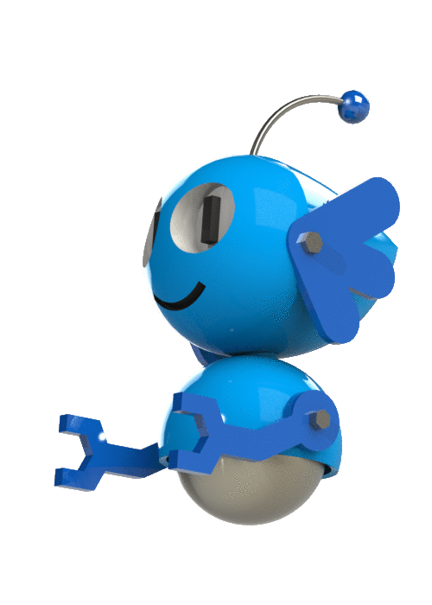
Tutorial
Runs a simplified maze level
Displays instructions “on top of” the game
Requires the player to complete certain tasks before progressing
Moving Forward/Backward
Turning
Calling the Pause Menu
Ending the Game
Runs the Celebration Routine at the end
Notes:
When typing text, insert the cursor on text above and start typing. Highlight text you do not want and press delete.
The placement of text blocks are strategically placed to relate to your intro slide (#1).
Main title: 40 pt. Times, Upper & lower case.
Subheads/Name: 16 pt. Helvetica Bold
Text: 16 pt. Helvetica light
Titles, papers, periodicals: 16 pt. Helvetica oblique

Slide 26


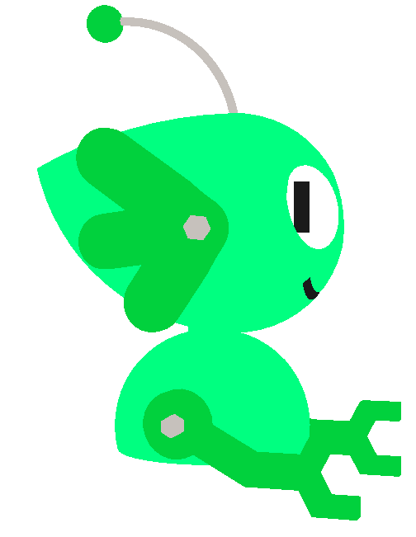
3D Model / OBJ Viewer
Draws in 3D any OBJ model from a file
Saves model into a local structure
Includes face colors
Colors can be changed for different players
Includes Move and Rotate classes

Slide 27


Celebration Routine
Draws an array of randomly initiated line Strips
Allows confetti strips to fall and move randomly, similar to Brownian motion
Infinite loop of confetti
Draws “on top of” 3D animation

Slide 28
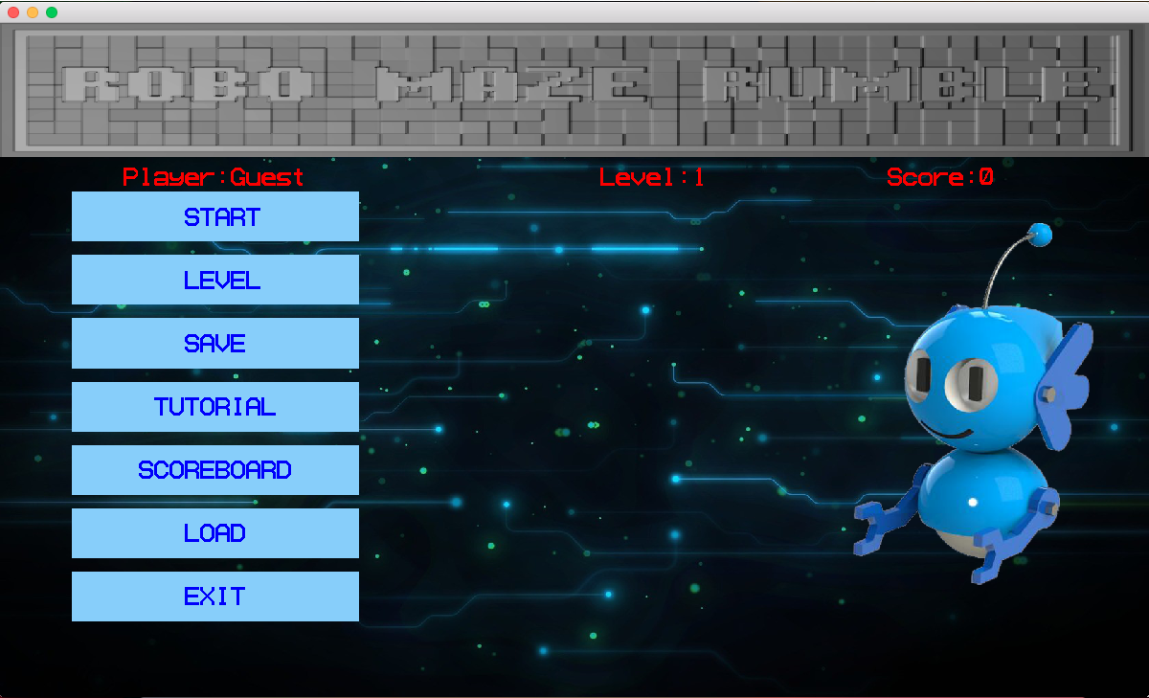
Menu
Objective
User interface
Loads , Save , Exit and Scoreboard
Call the Game : from the level selected by the user

Slide 29
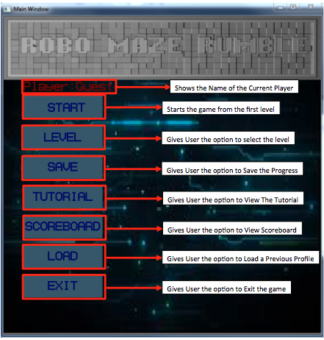
Draw
Draws the background
Draws the Buttons
Start
Level
Save
Tutorial
Scoreboard
Level
Exit

Slide 30
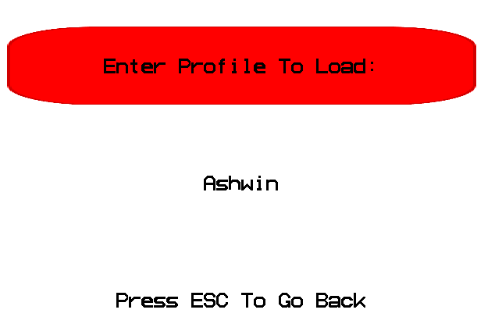
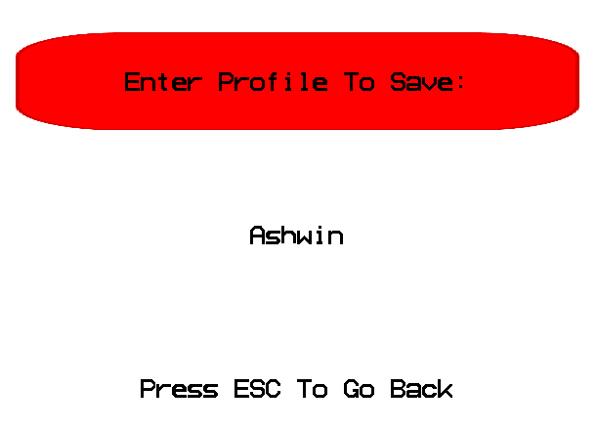
Utility Functions
Load
Save
Used to Load a Profile
Allows only 6 Characters as input
Displays Error otherwise
Used to Save the Profile
Allows only 6 characters as Input
Displays Error otherwise

Slide 31
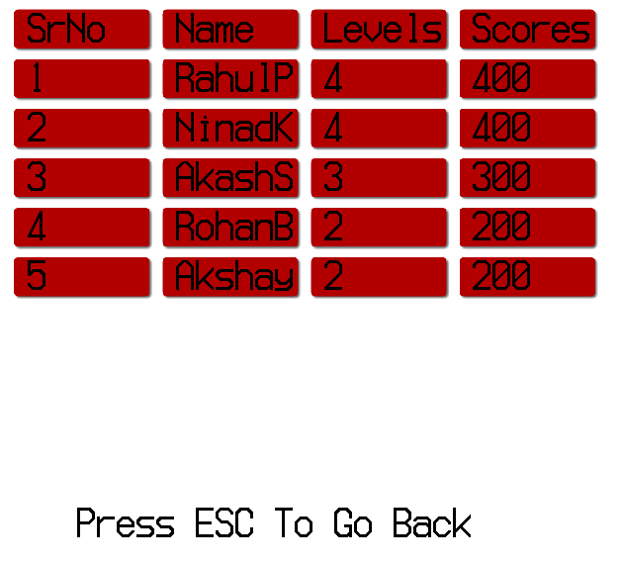
Scoreboard
Displays the Score of the Top 5 Players of the Game
Updates Every time a Profile is Updated or a New profile is created

Slide 32

Game Class - Purpose
Purpose
Chief orchestrator of the game
Communicate with component classes
Shift between levels
Provide user interface between levels
Keep track of score and level
Ideology
Robust and independent
Easy debugging
Encapsulation of functions
Easy integration
Handling life of objects between levels
Data protection

Slide 33
Game functions – Member variables
Level
Stores the current level of the player
Score
Stores the current score of the player
TargetReached
Stores the outcome of that level
All member variables are protected variables – Data is well protected!

Slide 34
Game Class – Member functions
Constructer – Only parameterized
Can only be called using level and score.
Copy Constructer and operator – Made private to prevent copy
Data recovery functions - public
GetLevel – provides the level
GetScore – provides the score
Interfacing function – public
Run – interfaces with main to run the class
Internal functions – protected
OneLevel – runs one level of the game
EndLevel – provides user interface at the end of the level

Slide 35
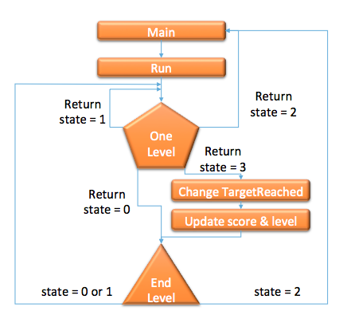
Game class – Run function
Runs OneLevel function
If returnstate is 0 or 3,
Sets TargetReached as per the result of OneLevel
Increments level based on TargetReached
Calls Endlevel function
If user chooses to go to Menu, terminates
If returnstate is 1, runs next loop – Since, level not changed, same level is restarted
If returnstate is 2, terminates

Slide 36

Game class – OneLevel function
Creates objects of maze, computer and human robots, and Astar algorithm
Selects maze size and speed of computer robot
Generates the maze
Provides path to computer robot
Draws and Moves both the robots
Four outcomes
Player looses – returnstate is 0
Player restarts the game – returnstate is 1
Player chooses to go to Menu – returnstate is 2
Player wins – returnstate is 3

Slide 37
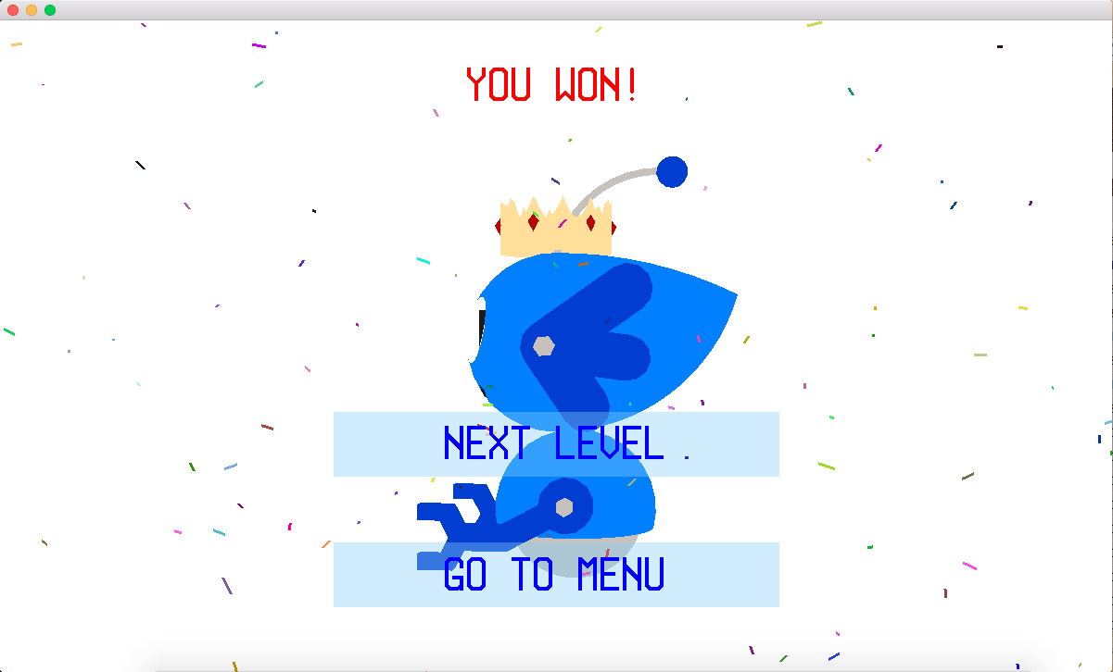
Game class – EndLevel function
Two major options after level
If player wins – Go to Next Level or Menu
If player looses – Restart the level or go to Menu
Can not use pause – does not make sense to have three options
Displays the outcome of the level
Communicates user choice to Run
Written to be accommodate resizing of the window
Does not display Next Level option at last level

Slide 38
Integration-Assembling code
Main Interacts with Menu, Game and Tutorial
Game and Tutorial interact with other components – maze, both robots, Astar and pause
Menu performs other functions apart from running the game and tutorial
Main
Menu
Game
One Level
Tutorial

Slide 39

Integration – optimization and improvements
Two A-star algorithms used initially
Combined into single class
std::priority_queue implementation
A more efficient way to satisfy requirements
Optimization of save, load and scoreboard features
Resizable window size and font size

Slide 40

Significant bugs and their fixes
Event queue from EndLevel
Fix: FsClearEventQueue command used before starting while loop to clear previous commands
Same restart and Go to Menu state in OneLevel
On choosing to restart from Pause menu, EndLevel would be called.
If above bug prevented, Endlevel won’t be called if player lost the level
Fix: Additional state for restart added.

Slide 41
Significant bugs and their fixes
Save functionality
Saving was not replacing old entry on scoreboard but just adding new one
Fix: Class for player created. Sorting based on names and updating
Inconsistent button performance
Click on button not registered at times
Tap select on laptop touchpad a problem as well
Fix: Using Mouse Event instead of Button State

Slide 42
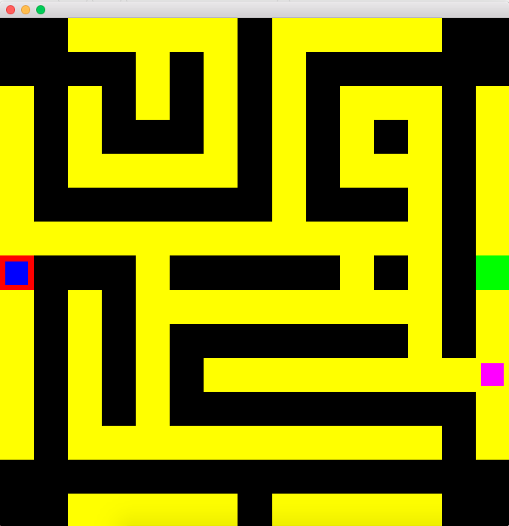
Final 2D game
This is how the 2D game looks finally
You go through a maze and beat the computer
Not good enough
We want more!
So, we go 3D!!

Slide 43
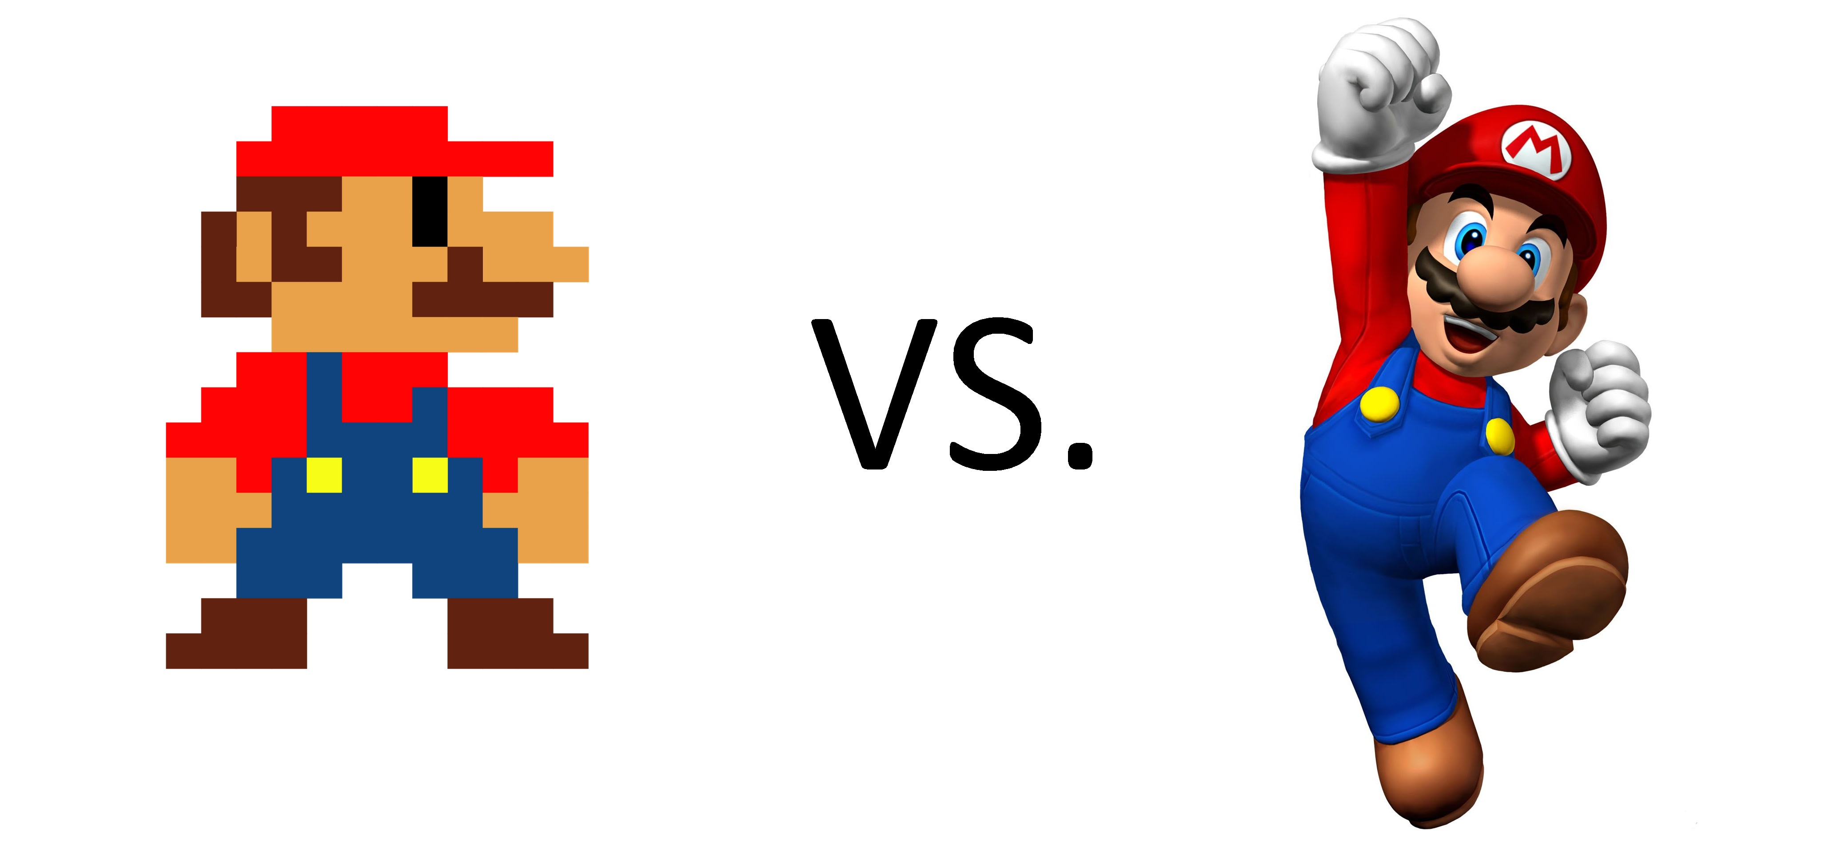

3D Implementation
Modifications in Maze
Drawing in 3D
Texture Mapping
Modifications in Robot
Draw of human robot similar to camera class
Move function with Key state rather than event
Alpha blending used for showing 2D map
Computer robot visible only in map
Separation of texture loading from texture drawing

Slide 44
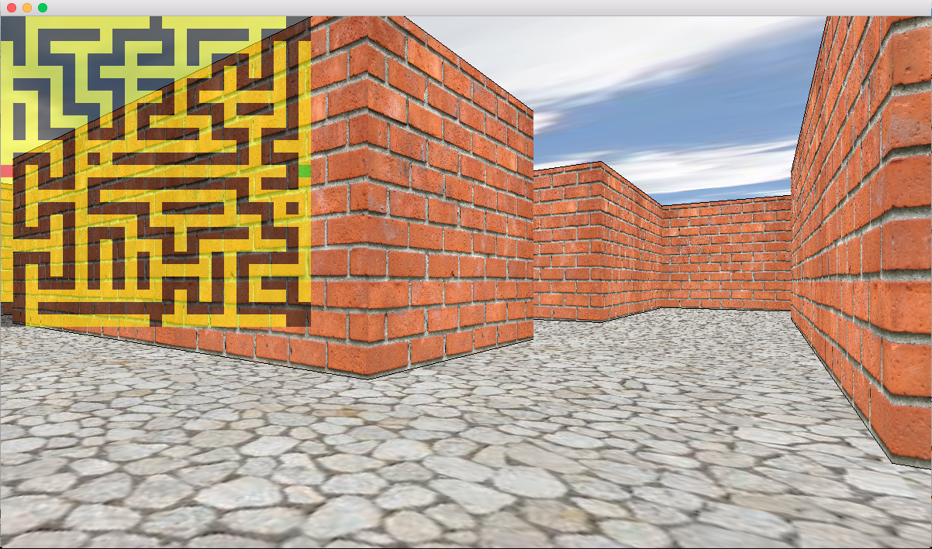
3D Maze
Texture Mapping
Draw 3D
Draw Wall
Draw Cube
Notes:
When typing text, insert the cursor on text above and start typing. Highlight text you do not want and press delete.
The placement of text blocks are strategically placed to relate to your intro slide (#1).
Main title: 40 pt. Times, Upper & lower case.
Subheads/Name: 16 pt. Helvetica Bold
Text: 16 pt. Helvetica light
Titles, papers, periodicals: 16 pt. Helvetica oblique

Slide 45
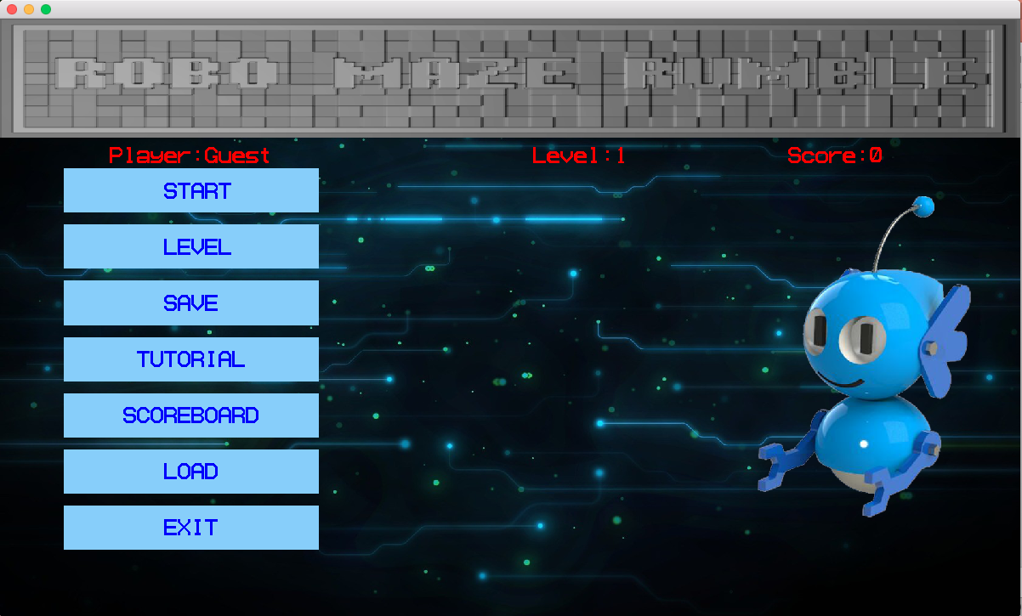
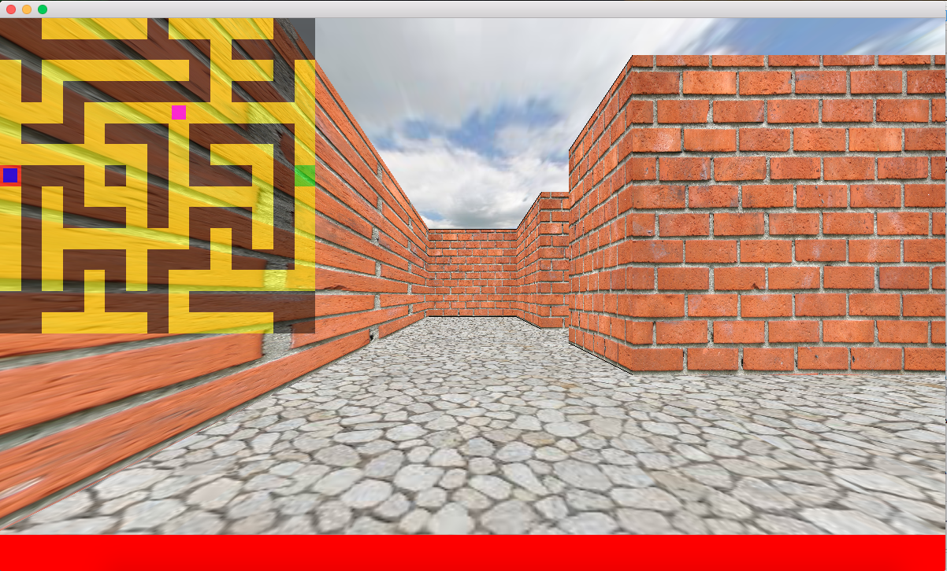
Final Product
Here are some of the images of the final game
But who likes to see images!
Let’s have the real deal…..Time for a live demo!!!

